Slide 1
Thinking like an architect
ARCHITECTURE WORKSHOP · INTRODUCTION
Six questions — and some established answers — before we look at our product’s architecture.
[Presenter name] · [Date]
Notes:
SAY (about 30 seconds) • The next 30 minutes are not a framework lecture. The aim is to get into the architect’s mindset before we look at our own product. • There are no wrong answers — notice how differently software, hardware, IT, network and business people think about the same words. TIME PLAN (about 27.5 minutes + 2.5 buffer) Intro 1.5 · Q1 architect 3 · Q2 role map 3 · Q3 what is architecture 3 · Q4 every system 3 · concepts 2.5 · Q5 drivers 5 (pairs) · Q6 still good 5 (pairs) · close 1.5. If you run late: shorten the concept build to one step (show only the last slide), and collect one answer per pair, no repeats. Hidden backup slides: “Is an architecture ever finished?” (after Q5) and “Conformance is not fitness” (after Q6). PREPARATION • Running example throughout: a simplified car — everyone knows one, and it spans hardware, software, networks and business. • Two flipcharts: one for Q3 words, one for Q6 measures. Keep both for the GQM workshop. • Pairs (Q5 and Q6): mix disciplines; keep the same pairs for both rounds. • Current architects in the room: ask them to answer last on Q1 and Q2 so they don’t anchor the others, and to act as a resource. CITATIONS (checked November 2026) Verified against your copies: ISO/IEC/IEEE 42010:2022 (definitions, Annex A, concept relationships), SAiP 4th ed. (architecture definition, ch. 1.1, architecture competence), CAiP (six principles, four essential activities, definition of an architect), BEA 2nd ed. (evolutionary architecture, fitness function, categories). Shown as paraphrase (not verified word for word): Maier & Rechtin (ASA), Conway, Hohpe.

Slide 2
How this session works
BEFORE WE START
Why: get into the architect’s mindset before we look at our product — and at how to measure it this afternoon.
1 · A question
2 · Reflect
3 · Answers
One question per slide. Think first — answers come after.
Mostly on your own, twice with your neighbour. Then share with the room.
Some established answers — not ‘the’ answer. Disagreeing is welcome.
LENSES FROM YOUR READING
SAiP
ASA
CAiP
BEA
Software Architecture in Practice
The Art of Systems Architecting
Continuous Architecture in Practice
Building Evolutionary Architectures
Bass, Clements & Kazman
Maier & Rechtin
Erder, Pureur & Woods
Ford, Parsons, Kua & Sadalage
Notes:
SAY (about 1 minute) • Rhythm: a question slide on its own, a minute to think, then we share — with ten of us we can simply talk. Twice you discuss with your neighbour. • Then some established answers. They are lenses, not “the” answer. • Several come from the four books you have read; the abbreviations on this slide are used throughout. When your book comes up, you are the expert in the room. • Our running example is a car — everyone knows one, and it has hardware, software, networks and a business behind it. • After this: our product’s architecture, and this afternoon the Goal-Question-Metric workshop. ASK • Quick show of hands: who read which book? BACKGROUND • We also use ISO/IEC/IEEE 42010:2022, the international standard for architecture description, which sits behind much systems engineering practice.

Slide 3

What is an architect?
QUESTION 1 OF 6
What does an architect do that a senior expert does not?
Reflect alone · 1 minute
Notes:
SAY (about 2 minutes including answers) • We start with you: everyone here is an expert, and many of you are moving towards an architect role. • One minute of silence, then share. ASK • Collect a few answers; current architects in the room answer last. • Follow-up: “And what would you have to let go of?” (deep technical work, being the one who knows the answer…) • If the room is quiet: go first yourself — what you had to let go of when you started architecting. BACKGROUND • Typical answers: sees the whole, talks to more stakeholders, makes trade-offs, decides less alone, influences without authority, more meetings.

Slide 4
What is an architect?
QUESTION 1 · SOME ESTABLISHED ANSWERS
CAiP · definition
SAiP · architecture competence
ASA · the client’s agent
“An architect is responsible for enabling the implementation of a software system by driving architectural decisions in a manner that protects the conceptual integrity of the software system.”
Duties, skills and knowledge — and much of it is communication, negotiation and leadership.
Helps the client find out what they need and can afford, and confirms the result is fit for purpose.
Erder, Pureur & Woods
Bass, Clements & Kazman (paraphrased)
Maier & Rechtin (paraphrased)
From expert to architect: depth → breadth · doing → enabling · how → why
Notes:
SAY (about 1 minute) • Compare with what the room said: which of your answers appear here — and which are missing? • CAiP: the architect enables the implementation by driving decisions and protecting conceptual integrity — not by making every decision alone. • The bottom line is a common observation, not a quotation: does it match what you said you would have to let go of? ASK • CAiP readers: CAiP also says architecture is “increasingly becoming a discipline (a skill) rather than a role”. Do you agree — and what would that mean here? • SAiP readers: which skill from the architecture competence chapter surprised you? BACKGROUND • CAiP principle 6 — “Model the organization of your teams after the design of the system you are working on” — makes architecture work a team responsibility: decisions and the architecture backlog are visible to the teams. • ASA borrows from building architecture: the architect represents the client, not the builder, and judges fitness for purpose. • Gregor Hohpe’s “Architect Elevator”: the architect rides between the penthouse (strategy) and the engine room (implementation) — a lead-in to the role map. HUMOUR (off slide) “An architect is someone who answers ‘it depends’ — and then explains on what.”

Slide 5

Where do these architects sit?
QUESTION 2 OF 6
Big picture
Where does each role sit — and how far does its reach extend?
Systems
Software
Solution
Security
Detail
Call it out · 2 min
Business / enterprise
Products
Notes:
SAY (about 2 minutes) • A shout-out, not an exercise: point at one role at a time and ask “where?”. Encourage disagreement — “shouldn’t it be above that one?” • For each role, also ask how big its bubble is: how far does its influence reach, across and up-and-down? ASK • Start with Systems — the role everyone knows from the systems engineering course — then Software, Solution and Security (the most contested). • Current architects answer last, so they don’t anchor the room. • If the room is quiet: place one role yourself, deliberately a little wrong, and let them correct you. BACKGROUND • If you present from PowerPoint in edit view you can drag the chips onto the chart; otherwise just point. • The next slide shows one possible picture with all eight common roles, drawn as bubbles. HUMOUR (off slide) “If anyone wants a role in all four corners at once, that’s either a chief architect or a job advert.”

Slide 6

Where do these architects sit?
QUESTION 2 · ONE POSSIBLE PICTURE
Big picture
Draw the bubble, not the dot.
Enterprise
Systems
Most roles span a range; the overlaps are where architects need each other.
Solution
Business
Where is your bubble today — and where do you want it to be?
Security
Software
Network
Hardware
Detail
Business / enterprise
Products
Notes:
SAY (about 1 minute) • One possible picture, not the answer — compare it with what the room said and invite challenge. • Each figure is a role; the bubble behind it is its typical reach. Wide bubbles reach across the organisation; tall ones reach from detail to the big picture. • The overlaps matter most: that is where architects need each other. ASK • Where is your bubble today — and where do you want it to be by the end of this programme? • Current architects: where would you draw your own bubble here? BACKGROUND • Enterprise and business architects work across the organisation, towards the big picture; solution architects bridge business needs and products. • Systems architects own the big picture of a product; software and hardware architects go deeper within it. • Network and especially security architects cut across the whole width. • Your organisation may draw it differently — that difference is worth a sentence, not a debate. HUMOUR (off slide) “If your bubble covers the whole chart, you are either the chief architect or the only architect.”

Slide 7
What is architecture?
QUESTION 3 OF 6
You have all worked with one — in hardware, software, networks or a business. What do they have in common?
Reflect alone · 1 minute
Notes:
SAY (about 2 minutes including answers) • One minute of silence, then one word or phrase each, round the room. • Write the words on flipchart 1; don’t correct anyone yet. ASK • If the room is quiet: “Think of a car. What makes something its architecture, rather than just a drawing of it?” BACKGROUND • Expected words: structure, components, interfaces, principles, decisions, constraints, rules, layers. You will compare them with the definitions on the next slide.

Slide 8
What is architecture?
QUESTION 3 · SOME ESTABLISHED ANSWERS
ISO/IEC/IEEE 42010:2022
SAiP · definition
ASA · definition
“Fundamental concepts or properties of an entity in its environment and governing principles for the realization and evolution of this entity and its related life cycle processes.”
“The set of structures needed to reason about the system. These structures comprise software elements, relations among them, and properties of both.”
The structure of a product, process or element — in terms of its components, connections and constraints.
In short: what is fundamental about a thing in its setting, and how it is built and changes.
Bass, Clements & Kazman
Maier & Rechtin (paraphrased)
Recurring ideas: structure · relationships · principles · environment · evolution
Notes:
SAY (about 1 minute) • Read the three side by side: which words from our flipchart appear here — and which of ours are missing? • 42010 says “entity”, not “software”: a product, a car, a system of systems, even an enterprise. It includes environment and evolution — architecture is not a snapshot. • SAiP: “needed to reason about” — we choose structures for a purpose, so there is no single complete architecture of anything. • ASA: constraints are part of the architecture, not just boxes and lines. ASK • SAiP and ASA readers: what does your book add that the slide leaves out? BACKGROUND • Martin Fowler’s shorthand (“Who Needs an Architect?”, 2003): architecture is about the things people perceive as hard to change. HUMOUR (off slide) “Architecture is about the important stuff. Whatever that is.” — Martin Fowler, “Who Needs an Architect?”

Slide 9
Does every system have an architecture?
QUESTION 4 OF 6
Even if nobody ever wrote it down?
Reflect alone · 1 minute
Notes:
SAY (about 1.5 minutes including answers) • One minute alone, then a quick show of hands: yes, no, it depends? ASK • To the “yes” camp: where is it, then — in the car itself? • To the “no” camp: if the documents say one thing and the running car another — which one is the architecture? • Follow-up: if every document were lost tomorrow, would the car still have an architecture? BACKGROUND • Likely answers: “the code (or the hardware) is the architecture”, “the real architecture is in people’s heads”, “the documents are the architecture”. All three appear on the next slide.

Slide 10
Architecture: two lenses and a description
QUESTION 4 · SOME ESTABLISHED ANSWERS
TWO LENSES ON THE ARCHITECTURE
NOT THE ARCHITECTURE ITSELF
Architecture as property
Architecture as conception
Architecture description
“A property or attribute of an entity of interest.”
“A conception of an entity in one’s mind.”
“Work product used to express an architecture.”
or
There whether or not anyone wrote it down.
Two people can hold different ones.
Tangible — the architecture itself is intangible and abstract.
42010:2022, Annex A
42010:2022, Annex A
42010:2022
Gap 1 · between people
Gap 2 · intention vs. reality
Different conceptions of the same system. Closed by alignment.
The built system drifts from the intended one. Caught by continuous checking.
Entity of interest = whatever we are architecting: a product, system, service or enterprise.
Notes:
SAY (about 1.5 minutes) • Both camps from the question are right — 42010 deliberately names two lenses and “does not presume any one of these metaphors”. • Property: the car has an architecture whether or not anyone wrote it down. Conception: before anything is built, the architecture exists only as ideas — and two people’s ideas can differ. • Either way, the description is something else: a tangible work product about the architecture, not the architecture itself. • That gives two gaps to manage: between people (alignment — what an AD is for) and between intention and reality (drift — what continuous checking is for; question 6 picks this up). • Close the topic: “Let’s park the philosophy — drift is what we will measure this afternoon.” ASK • SAiP readers: chapter 1.1 says every software system has an architecture — even if nobody knows it any more. Does that match the property lens? BACKGROUND • SAiP 1.1 (“Every software system has a software architecture”): the architecture may be unknown to everyone — for example when all who knew it have left, or the source code is gone. • Martin Fowler (“Who Needs an Architect?”) quotes Ralph Johnson: architecture as the expert developers’ shared understanding of the system design — the conception lens. • 42010 Introduction: “Whereas an AD is a tangible work product, an architecture is intangible and abstract.” • More on what to do when system and description disagree: hidden backup slide “Conformance is not fitness”, after question 6. HUMOUR (off slide) “Every system has an architecture. Some are undocumented; others are documented but fictional.”

Slide 11


The concepts we architect with
VOCABULARY · SIMPLIFIED, AFTER ISO/IEC/IEEE 42010:2022
Environment
is situated in
Entity of
interest
Architecture
has
is part of the
character or
nature of
Aspect
The entity and its architecture
Notes:
STEP 1 OF 3 — THE ENTITY (about 30 seconds) SAY • This follows from question 4: once we separate the architecture from its description, we need words for what is involved. We build it in three steps. • The entity of interest is whatever we are architecting — here, the car. (The 2011 edition said “system”.) • It is situated in an environment — roads, drivers, regulation, the charging network — and it has an architecture. • Aspects are part of its character or nature: its structure, behaviour, safety, cost. BACKGROUND • Relationship names follow ISO/IEC/IEEE 42010:2022, simplified (checked against the standard).

Slide 12

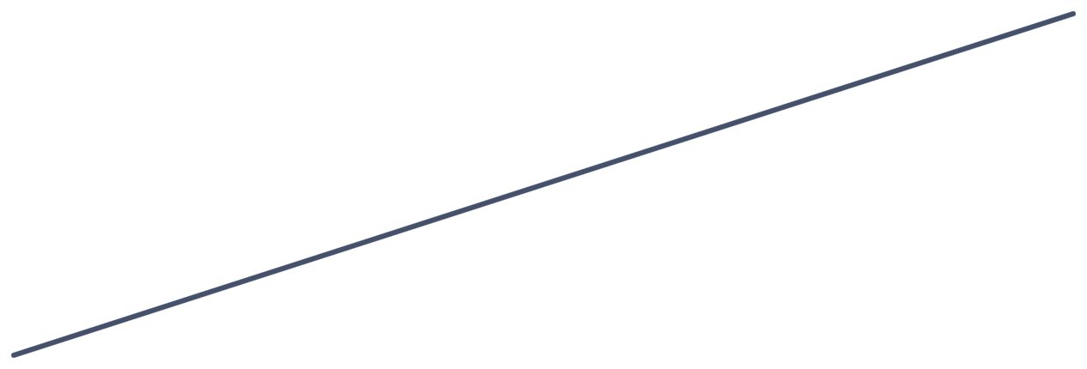

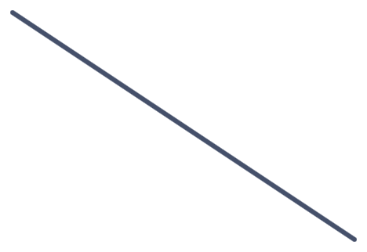
The concepts we architect with
VOCABULARY · SIMPLIFIED, AFTER ISO/IEC/IEEE 42010:2022
sees things
from
Environment
Stakeholder
Stakeholder
perspective
is situated in
has an
interest in
has an
interest in
is a matter of
importance for
results in
Entity of
interest
Architecture
Concern
has
is part of the
character or
nature of
Aspect
The entity and its architecture
Stakeholders and their concerns
Notes:
STEP 2 OF 3 — THE PEOPLE (about 1 minute) SAY • Stakeholders have an interest in the car and in its architecture: driver, owner, regulator, workshop mechanic, the manufacturer’s finance team. • Each sees things from a stakeholder perspective — safety, cost, ease of repair — which results in concerns: “Will it pass the crash test?”, “What does an over-the-air update cost us?” • Those concerns are matters of importance for the stakeholder. The loop is the point: concerns come from people, not from the system. ASK (optional, 20 seconds) • Who is a stakeholder of the car that nobody would think of first?

Slide 13
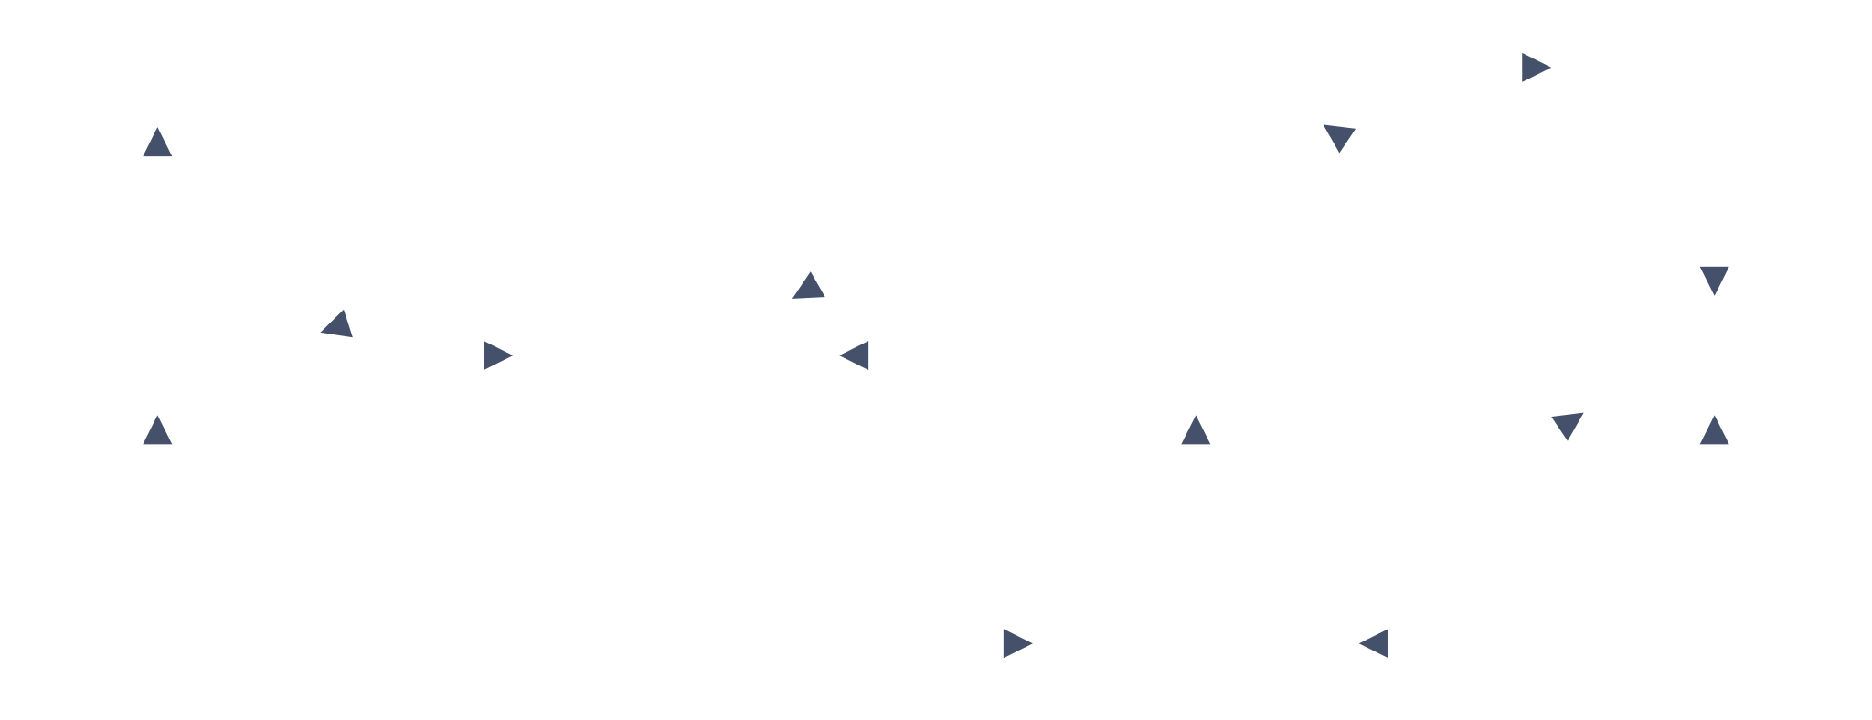

The concepts we architect with
VOCABULARY · SIMPLIFIED, AFTER ISO/IEC/IEEE 42010:2022
sees things
from
Environment
Stakeholder
Stakeholder
perspective
is situated in
has an
interest in
has an
interest in
is a matter of
importance for
results in
Entity of
interest
Architecture
Architecture
description
Concern
has
expresses
is part of the
character or
nature of
is contained in
addresses
frames
Aspect
Architecture
view
Architecture
viewpoint
is evidenced in
governs
The entity and its architecture
Stakeholders and their concerns
The architecture description
Notes:
STEP 3 OF 3 — THE DESCRIPTION (about 1 minute) SAY • An architecture description expresses the architecture. It contains views — for the car, e.g. an electrical and network view, a software deployment view, a cost view. • Each view is governed by a viewpoint, which frames particular concerns; the view addresses those concerns, and aspects of the car are evidenced in it. • The second loop: viewpoint → view → concern. A view is only useful if it answers someone’s concern — which is why one diagram never satisfies everyone. ASK (optional, 30 seconds) • Which of these concepts do you already use — perhaps under a different name? (Systems engineers: viewpoints and views from MBSE frameworks; software: C4 or arc42; enterprise: TOGAF.) BACKGROUND • Left out for simplicity: view components (2011: “architecture models”) and model kinds, correspondences between AD elements, and architecture decisions and rationale. • A simplified drawing, not a copy of the standard’s figure; relationship names checked against ISO/IEC/IEEE 42010:2022.

Slide 14
What drives architecture?
QUESTION 5 OF 6
Two systems with the same functions can end up with completely different architectures. Why?
Discuss with your neighbour · 3 minutes
Notes:
SAY (about 4 minutes: 3 in pairs, 1 collecting) • First of the two pair discussions. Pairs mix disciplines; keep the same pairs for question 6. • Each pair agrees on one driver to report. ASK • Collect one driver per pair, no repeats, and cluster them as you go: quality attributes (safe, fast, secure, easy to update) · constraints (regulation, cost, suppliers, legacy platform) · business goals (time to market, number of variants, premium vs. budget) · people and organisation. • If nobody mentions the organisation: would the car look different if it were built by one team in one room, or by five suppliers in three countries? BACKGROUND • Car examples: a premium and a budget car with the same functions differ in cost targets and variant strategy; an EV platform built for over-the-air updates differs from one where software is fixed at the factory.

Slide 15
What drives architecture?
QUESTION 5 · SOME ESTABLISHED ANSWERS
SAiP · CAiP
SAiP · ASA
SAiP · ASA
CAiP · Conway’s law
Quality attributes
Constraints
Business goals
The organisation
Safety, performance, security, modifiability… the qualities, not the functions.
Regulation, standards, legacy, cost: decisions already made for you.
Time to market, product strategy, the client’s purpose.
Teams shape the system, and the system shapes the teams.
CAiP · principle 2
ASA · heuristic (paraphrased)
“Focus on quality attributes, not on functional requirements.”
Don’t assume the original problem statement is the right one.
Notes:
SAY (about 1 minute) • Map the pairs’ answers onto the four boxes: which of yours fit — and which don’t fit any box? Keep those visible. • Quality attributes do most of the shaping: two cars with the same functions differ because one must be cheaper, safer, or updatable over the air. ASK • CAiP readers: why does CAiP make this a principle rather than a requirement type? • ASA readers: an example from your book of questioning the problem statement? BACKGROUND • SAiP: architecturally significant requirements (ASRs) are requirements that have a profound effect on the architecture. Most are quality attributes, and they are often not written down — the architect has to dig them out of stakeholders. BEA calls them “architectural characteristics”. • SAiP also stresses that qualities conflict (e.g. security vs. performance), and that architecture makes the trade-offs explicit. • Conway’s law (Melvin Conway, 1968), paraphrased: organisations that design systems produce designs that copy their own communication structures. CAiP principle 6 turns this round: model the organisation of your teams after the design of the system. HUMOUR (off slide) “Fast, cheap, good — pick two. Architects get asked for all three, plus secure.”

Slide 16
How would you know your architecture is still good — today?
QUESTION 6 OF 6
Not at the next review gate. What could you observe or measure — and how often?
Discuss with your neighbour · 3 minutes
Notes:
SAY (about 4 minutes: 3 in pairs, 1 collecting) • Second and last pair discussion — same pairs as question 5. Think of the car first, then our product. • Write their measures on flipchart 2 and keep it for the GQM workshop this afternoon. ASK • Push with: good for whom? Which quality? Measured how — and who would act on the result? • If a discipline stays quiet, offer a car example from it: – Hardware: re-spins of a control-unit board per change; thermal margin; parts at risk of obsolescence. – Software: time to ship an over-the-air update; dependency rules broken per release. – Network: bus load on the in-car network; failed connections per 1,000 km; configuration drift from baseline. – IT and operations: days to patch a vulnerability across the fleet; unsupported components in the back end. – Business: time from idea to customer; cost per extra variant; warranty cost per architectural flaw. BACKGROUND • Typical answers: review outcomes, test results, build and integration times, field defects, coupling metrics, lead time per change, onboarding time for a new engineer.

Slide 17

Making ‘good’ observable
QUESTION 6 · SOME ESTABLISHED ANSWERS
SAiP · quality attribute scenario
BEA · fitness function
CAiP · essential activities
Source · stimulus · environment · artefact · response · response measure
“An architectural fitness function is any mechanism that provides an objective integrity assessment of some architectural characteristic(s).”
Focus on quality attributes · drive architectural decisions · know your technical debt · implement feedback loops
The response measure turns a quality from an adjective into something testable.
Bass, Clements & Kazman
Ford, Parsons, Kua & Sadalage
Erder, Pureur & Woods
This afternoon: Goal → Question → Metric for our own product.
Notes:
SAY (about 1 minute) • Compare with the measures on flipchart 2. • SAiP: the response measure turns a quality from an adjective into something testable. Without it, “safe” or “highly available” is only an adjective. • BEA: a fitness function is any check — automated or manual — that shows objectively whether a key characteristic still holds. “Maintainable” cannot be one; “no cyclic dependencies between modules” or “95th-percentile response under 200 ms” can. • CAiP: feedback loops are what make architecture continuous rather than a phase. ASK • BEA reader: one fitness function from your book. CAiP reader: what is a feedback loop in CAiP’s sense? BACKGROUND • Two kinds of measurement, worth naming if the flipchart is all one kind: conformance (does the system match the intended architecture?) and fitness (does the architecture meet its goals?). A car can conform perfectly to a poor architecture. GQM starts from goals, so it leads to fitness measures. Details: hidden backup slide that follows. • BEA’s fitness function categories include atomic/holistic, triggered/continual, static/dynamic and automated/manual. HUMOUR (off slide) “Without a measure, ‘the architecture is fine’ is an opinion. With one, it is still an opinion — but a better-informed one.”

Slide 18

Three questions to carry into the day
BEFORE WE LOOK AT OUR PRODUCT
Which decisions in our product would be most expensive to change?
What drives them — quality attributes, constraints, business goals or the organisation?
How would we know, continuously, that they still hold?
This afternoon: Goal → Question → Metric
Notes:
SAY (about 1.5 minutes) • These three questions are the thread through the rest of the day: we use them when we walk through our product’s architecture. • Point to the two flipcharts: the words from question 3, and the measures from question 6. The third question is exactly where the Goal-Question-Metric workshop starts this afternoon. ASK • Each person: pick the one question you will watch for today. BACKGROUND • Leave this slide up, or copy the three questions onto a flipchart, so you can point back to them later.

